Slide 1
Performance Analysis of Smart Automation Systems
Mentor – Jetendra Joshi Sir
Group Members:
Abhinav parihar
Hitika handa
S.R.Rahul
Karanam rakesh
Kandula Mohan sai
dandu geet kamal tej

Slide 2
Preview
Rationale of work.
Objective.
Methodology.
Literature Review.

Slide 3
Rationale of work
Internet of Things.
Smart Automation Systems.
Smart City.
Residential Automation.
Commercial Automation.
Performance Enhancement of Physical layer.
Arduino.
Raspberry Pi.
Lora WAN

Slide 4
Internet of Things
Internet of Things (IoT) mostly about physical objects and concepts communicating with each other.
Internet of Everything (IoE) is what brings in network intelligence to bind all these concepts into a cohesive system.
According to Cisco, “the Internet of Everything is the intelligent connection of people, process, data and things
Notes:
The Internet of Things or IoT is the internetworking of physical devices, vehicles, buildings, and other items.
They are embedded with electronics, software, sensors, actuators, and network connectivity that enable these objects to collect and exchange data.

Slide 5
Internet of Things
Image Courtesy: http://www.iritech.com/blog/internet-of-things-1016/

Slide 6
SMART Environment
A physical world that is richly and invisibly interwoven with sensors, actuators, displays, and computational elements.
They are embedded seamlessly in the everyday objects of our lives, and connected through a continuous network.

Slide 7
SMART City
A smart city is an urban development vision to integrate multiple information and communication technology (ICT) and Internet of Things (IoT) solutions.
The goal of building a smart city is to improve quality of life.
It uses urban informatics and technology to improve the efficiency of services and meet residents' needs.
Notes:
ICT (information and communications technology - or technologies) is an umbrella term that includes any communication device or application, encompassing: radio, television, cellular phones, computer and network hardware and software, satellite systems and so on, as well as the various services and applications associated with them, such as videoconferencing and distance learning. ICTs are often spoken of in a particular context, such as ICTs in education, health care, or libraries.

Slide 8
SMART Environment/SMART City
Image Courtesy: http://www.districtoffuture.eu/uploads/imagenes/imagenes_meetinpoint_smart-city_2b637ab6.jpg

Slide 9
Digital India
Prime Minister Narendra Modi’s vision “Digital India,” has set an ambitious plan to build 100 smart cities across the country.
Modi in his speech quoted, “Cities in the past were built on riverbanks. They are now built along highways. But in the future, they will be built based on availability of optical fiber networks and next-generation infrastructure.”
Image Courtesy: http://digitalindia.gov.in/

Slide 10
Commercial Automation
Building automation is also called as Commercial Automation.
It is the automatic centralized control of building's conditions through a building automation system (BAS).
heating, ventilation and air conditioning.
lighting etc.
The objectives of building automation are improved occupant comfort, efficient operation of building systems, and reduction in energy consumption.

Slide 11
Commercial Automation
Image Courtesy: http://www.regelgroup.com/main/building-automation-systems-bas/

Slide 12
Home automation
Home automation or smart home is the residential extension of building automation
It involves the control and automation of HVAC, and security, as well as home appliances and use Wi-Fi for remote monitoring.
Washer/Dryers,
Ovens.
Refrigerators/Freezers.
Television etc.

Slide 13
Home automation
Image Courtesy: http://blog.nxp.com/home-and-building-automation/home-automation-smart-lighting-gets-you-in-the-door

Slide 14
Physical layer
Physical layer is the lowest layer of OSI Model.
It is responsible for sending bits from one computer to another.
This layer deals with the physical connection to the network and with transmission and reception of signals.
Arduino.
Raspberry Pi.
Lora WAN

Slide 15
Physical layer
Image Courtesy: https://www.cooking-hacks.com/documentation/tutorials/lorawan-for-arduino-raspberry-pi-waspmote-868-900-915-433-mhz/

Slide 16
Arduino or Raspberry Pi?
Image Courtesy: http://makezine.com/2015/12/04/admittedly-simplistic-guide-raspberry-pi-vs-arduino/

Slide 17
Microcontroller vs. microprocessor
The Arduino employs an 8-bit AT mega series microcontroller.
The Raspberry Pi is based around a 32-bit ARM processor.
The Arduino is typically clocked at between 8-16MHz and with 2-8kB of RAM.
The RPi can be clocked at up to 1GHz and may have up to 512MB of RAM.
On top of which the Pi has a GPU and video outputs, Ethernet as standard and USB host ports.

Slide 18
Arduino or Raspberry Pi?
The Pi has a clear advantage for complex networked and high performance embedded applications and those which involve driving a video display or USB peripherals.
Arduino will only consume micro-watts when in sleep mode compared to the watts drawn by an idle Raspberry Pi running Linux.
Notes:
Is there a simple rule of thumb to help me decide?
Yes, there is! Think about what you want your project to do. If you can describe it with less than two ‘and’s, get an Arduino. If you need more than two ‘and’s, get a Raspberry Pi.
Examples: “I want to monitor my plants and have them Tweet me when they need water.” That can best be done by an Arduino.
“I want to monitor my plants and have them Tweet me when they need water and check the National Weather Service, and if the forecast is for fair weather, turn on the irrigation system and if the forecast is for rain, do nothing.” That would best be handled by a Raspberry Pi.

Slide 19
Objective
Performance Analysis of various devices in physical layer by building a testbed of Home Automation system.
Study of different performance parameters of an automation system.
Performance Analysis of different protocols (MQTT, HTTP and CoAP).

Slide 20
Methodology
To design a testbed of Home Automation for performance analysis of physical layer.
Arduino.
Raspberry Pi.
To study the different performance parameters related to automation system.
To analyse the performance of protocols in network layer.
To enhance the performance by adapting efficient protocols.
To design a testbed of Home Automation using Lora WAN for best performance.

Slide 21
Home Automation System
Image Courtesy: http://randomnerdtutorials.com/nrf24l01-2-4ghz-rf-transceiver-module-with-arduino/
http://hack.lenotta.com/arduino-raspberry-pi-switching-light-with-nrf24l01/

Slide 22
Software
Our plan to communicate between these two is to use a application to run a binary ‘sudo ./remote -m 81‘ and ‘sudo ./remote -m 80‘ sending a message to the Arduino with the text 81 and 80 .
The message is composed by pin identifier (8) and action to perform (0|1|2).
After the action has been read, all the other numbers identify the pin which the action refers to.

Slide 23
Flow model
Image Courtesy: http://blog.carr3r.com/post/raspberry-pi-b-and-arduino-talking-through-nrf24l01-modules/

Slide 24
Sketching
We used the library package ‘Optimized RF24 NRF24L01 Radio Library for Arduino’ - despite the name, this package also includes the libraries that we're going to use within the Raspberry.
So, download the library, import it into the Arduino (Sketch->Import library).
Prepare the environment at the Raspberry:
$ git clone https://github.com/TMRh20/RF24.git
$ cd RF24
$ sudo make install

Slide 25
Performance Parameters (Qos)
Network Delay is an important design and performance characteristic of a computer network. The delay of a network specifies how long it takes for a bit of data to travel across the network from one node or endpoint to another.
Throughput is the rate of successful message delivery over a communication channel.
Reliability is the overall consistency of a measure. A measure is said to have a high reliability if it produces similar results under consistent conditions.
A reliable protocol provides reliability properties with respect to the delivery of data to the intended recipient(s), as opposed to an unreliable protocol, which does not provide notifications to the sender as to the delivery of transmitted data
Network latency is the time from the source sending a packet to the destination receiving it.

Slide 26
LORAWAN
LoRaWAN is a Low Power Wide Area Network
Support low-cost
Mobile
Secure bi-directional communication for Internet of Things (IoT), machine-to-machine (M2M), and Smart city
Low power consumption
Designed to support large networks with millions and millions of devices

Slide 27
How Does LoRaWAN Work?
It is typically laid out in a star-of-stars topology.
Gateways are a transparent bridge relaying messages between end-devices and a central network server in the backend.
Gateways are connected to the network server via standard IP connections.
End-devices use single-hop wireless communication to one or many gateways.

Slide 28
How Does LoraWAN Work?
Image Courtesy: https://www.lora-alliance.org/what-is-lora/technology
Notes:
Hardware Abstraction Layer (HAL, hardware abstraction) - abstraction layer, implemented in software, which is between the physical layer hardware and software running on the computer. HAL is designed to hide differences in hardware from the main part of the operating system kernel, so that most of the code that runs in kernel mode, do not need to be changed when it starts on a variety of hardware systems.

Slide 29
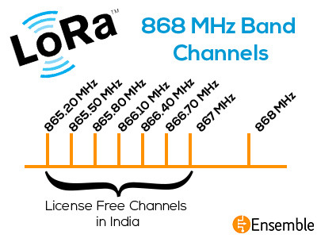
Frequency Bands
Lora WAN operates in unlicensed radio spectrum.
It is similar to WiFi, which uses the 2.4GHz and 5GHz ISM bands
Lora WAN uses lower radio frequencies with a longer range.
This poses a challenge for Lora WAN, that tries to be as uniform as possible in all different regions of the world. As a result, Lora WAN is specified for a number of bands for these regions.
A major portion of the 868 MHz LoRa frequency channels are in the license free 865 MHz – 867 MHz band in India. Seven out of the eight channels are in the license free band in India.

Slide 30
Literature review
[1] Jordi Mongay Batalla, George Mastorakis and Constandinos X. Mavromoustakis, "On cohabitating networking technologies with common wireless access for home automation system purposes", IEEE Wireless Communications ( Volume: 23, Issue: 5, October 2016 ).
[2] Sean Dieter Tebje Kelly, Nagendra Kumar Suryadevara and Subhas Chandra Mukhopadhyay, “Towards the Implementation of IoT for Environmental Condition Monitoring in Homes”, IEEE Sensors Journal ( Volume: 13, Issue: 10, Oct. 2013 ).
[3] Marco Centenaro, Lorenzo Vangelista and Andrea Zanella, “Long-range communications in unlicensed bands: the rising stars in the IoT and smart city scenarios”, IEEE Wireless Communications ( Volume: 23, Issue: 5, October 2016 ).
[4] Pierre Neumann, Julien Montavont and Thomas Noël, “Indoor deployment of low-power wide area networks (LPWAN): A LoRaWAN case study”, 2016 IEEE 12th International Conference on Wireless and Mobile Computing, Networking and Communications (WiMob).
[5] Jo¨el Toussaint, Nancy El Rachkidy and Alexandre Guitton, “Performance analysis of the on-the-air activation in LoRaWAN”, Information Technology, Electronics and Mobile Communication Conference (IEMCON), 2016 IEEE 7th Annual.

Slide 31
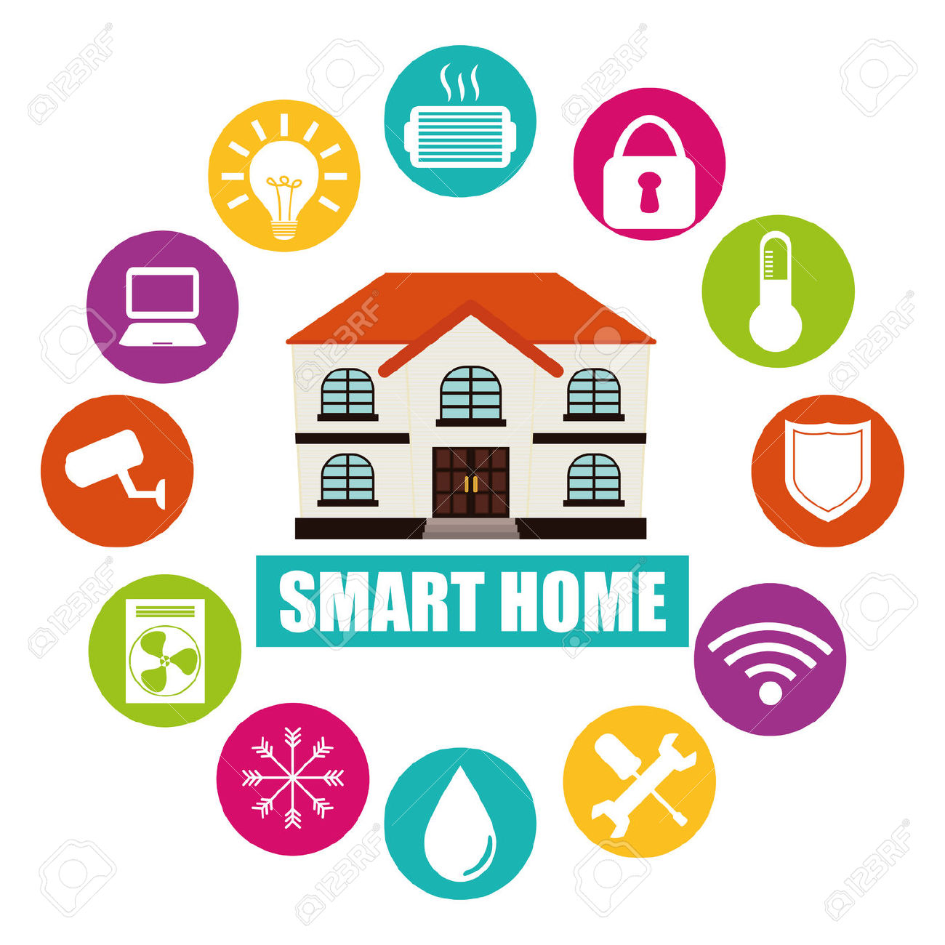
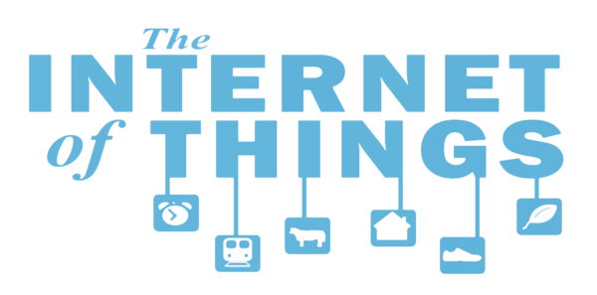
Thank you

