Slide 1
NU-RAP PRESENTATION
Project Title : Development of PID controller on arm cortex M4 processor and integration of webserver for monitoring purpose.
Project instructor - Mr. Jetendra Joshi
Project Members -
- Samit Singh(III, ECE) -Vishal(II,CS) -S R Rahul(II,ECE)

Slide 2
Additional goals :
Getting Started kit with ARM processor based microcontroller.
Getting Started kit with ARDUINO.
Getting Started kit with Raspberry Pi.

Slide 3
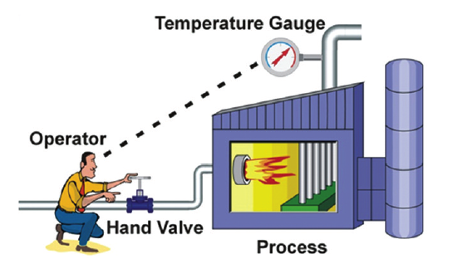
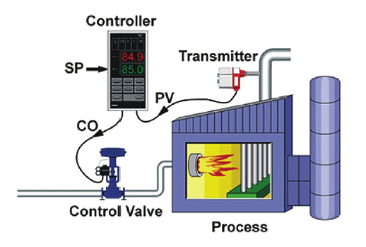
CONTROL MODES
Manual Control
Automatic Control

Slide 4
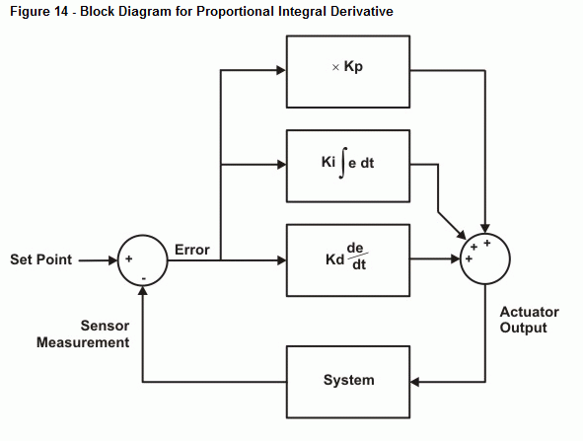
Proportional–Integral–Derivative Controller (PID Controller)

Slide 5
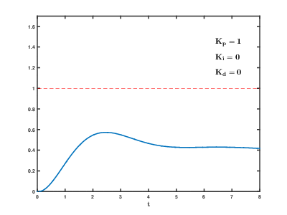
Effects of varying PID parameters (K_{p}, K_{i}, K_{d}) on the step response of a system.

Slide 6
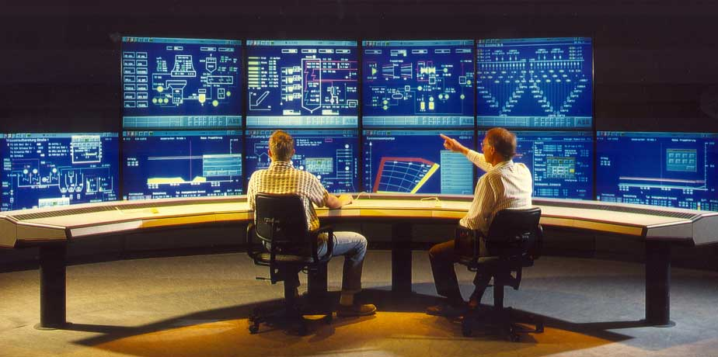
CONTROL & INSTRUMENTATION LAB

Slide 8
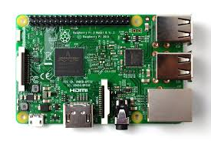
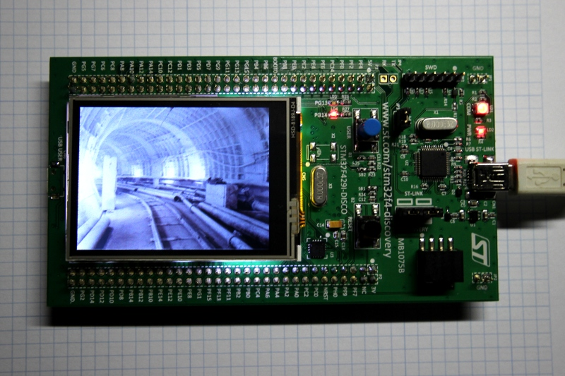
ARDUINO Raspberry pi ARM stm32f
GETTING STARTED WITH THE EMBEDDED SYSTEMS

Slide 9
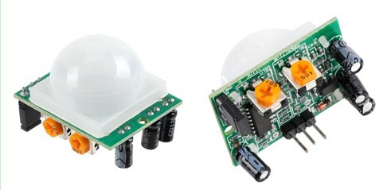
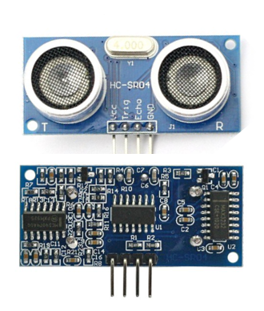
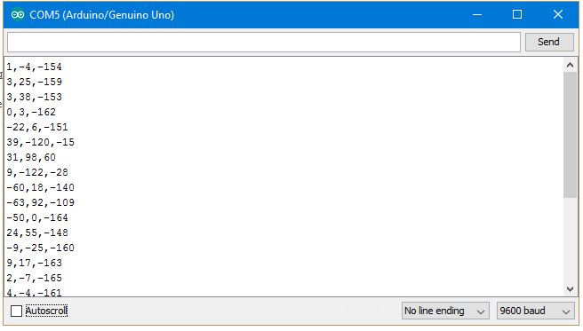
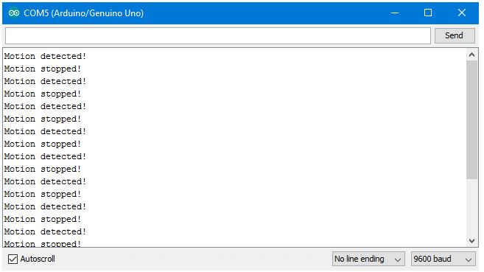
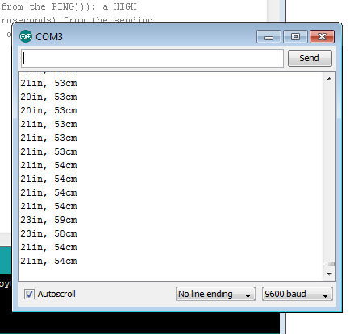
Integrating different sensors with Arduino, Raspberry Pi and ARM based microcontroller

Slide 10
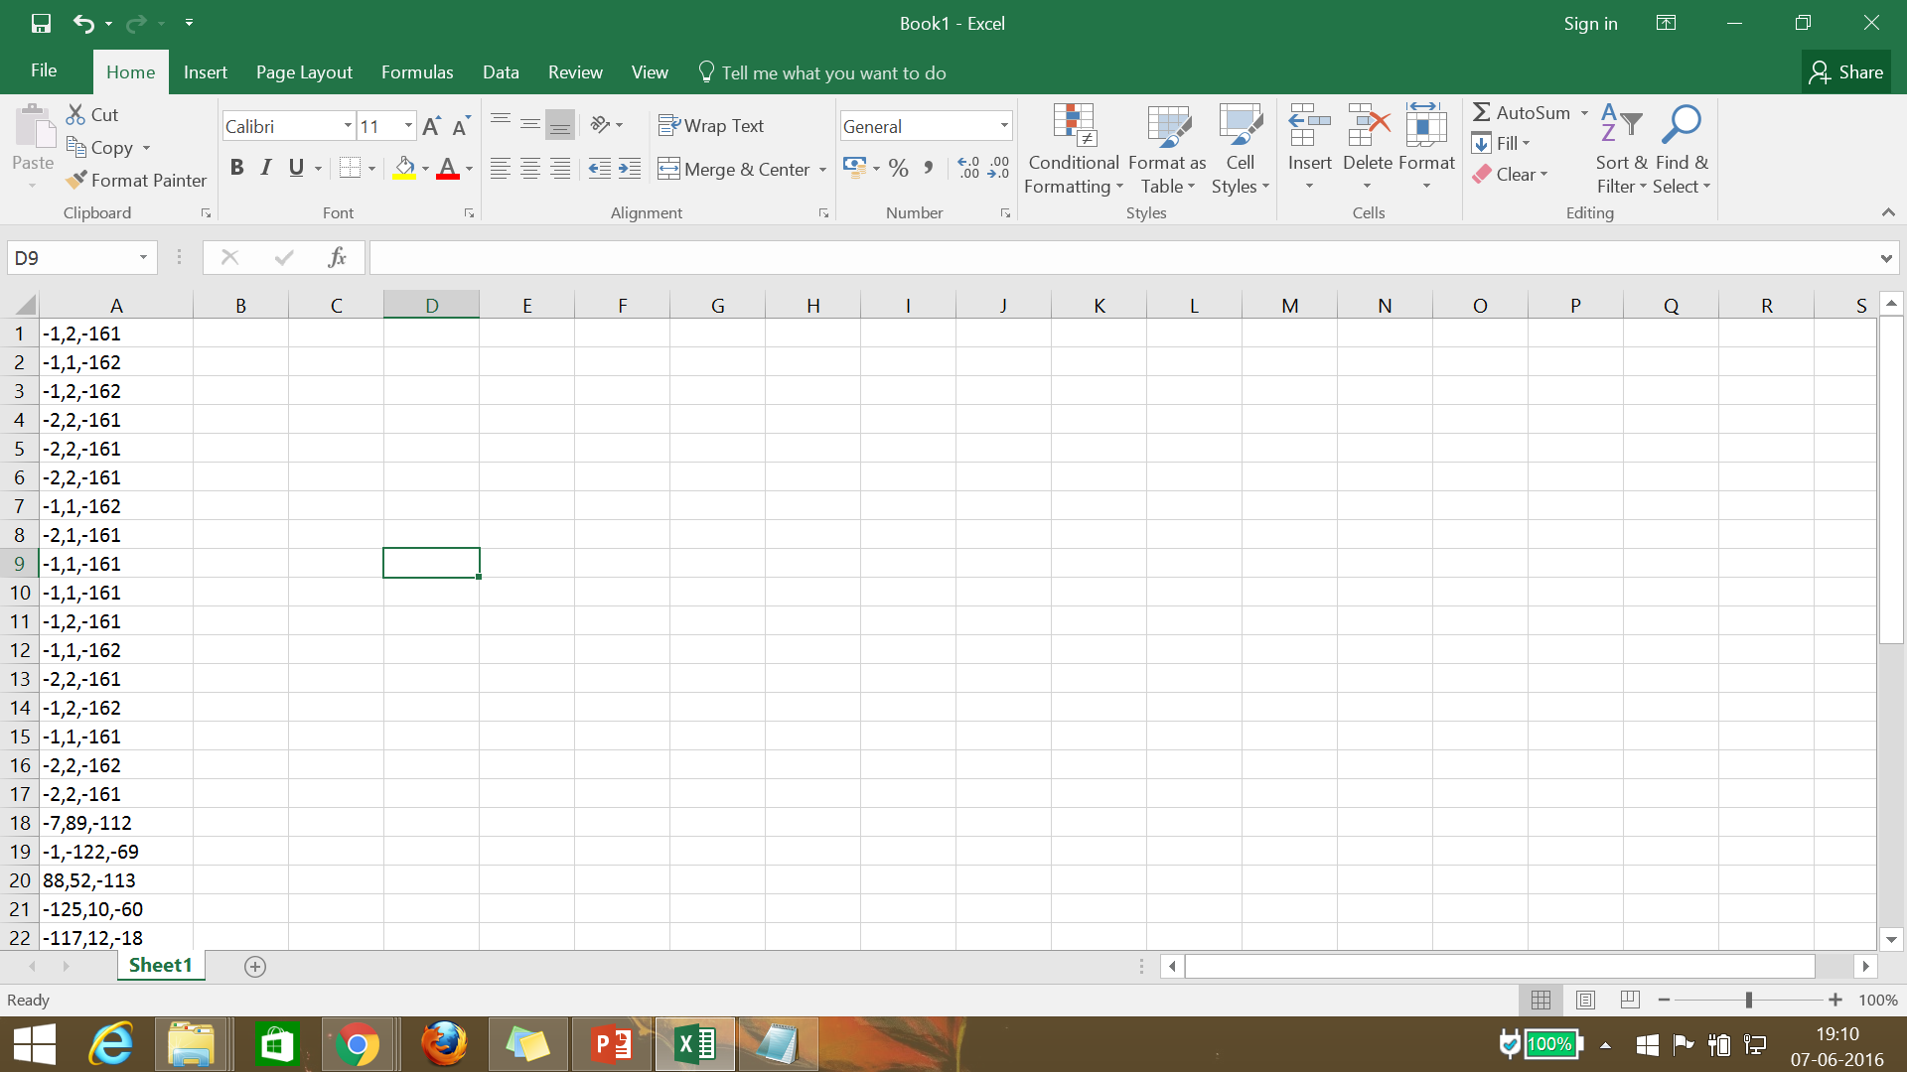
READING DATA FROM ARDUINO TO NOTEPAD/EXCEL TO PC

Slide 11
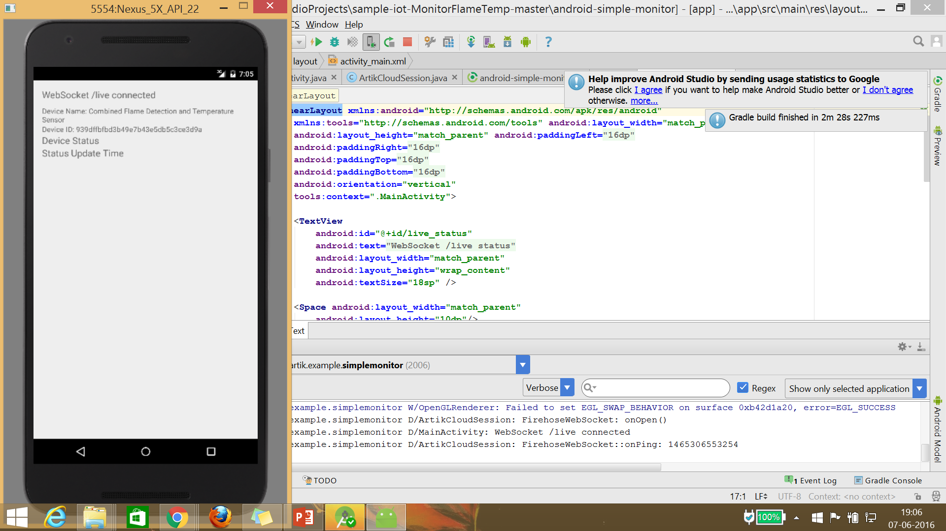
Process Variable Monitoring using Artik Cloud ( IoT based Cloud )

Slide 12
IBM BLUEMIX CLOUD

Slide 13
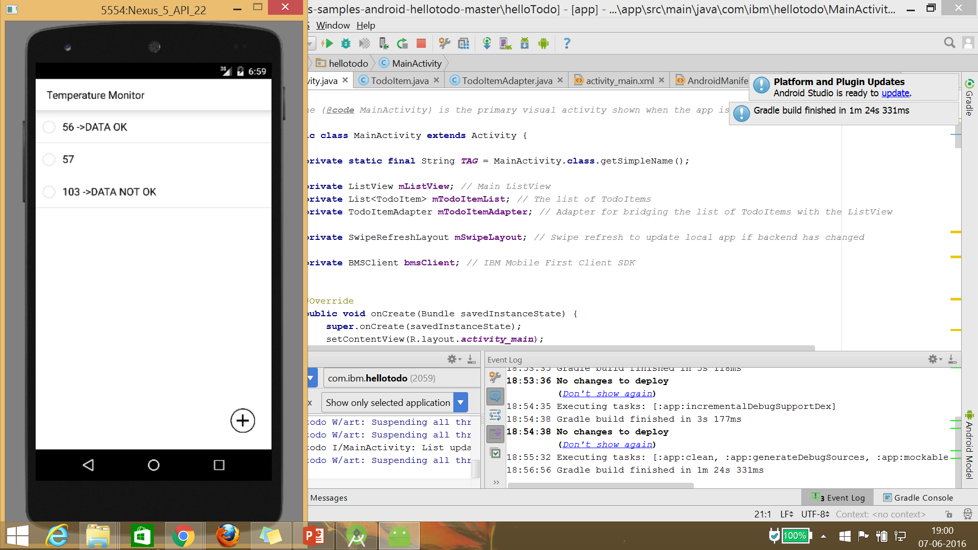
SYNCING DATA FROM ANDROID APP TO CLOUD

Slide 14
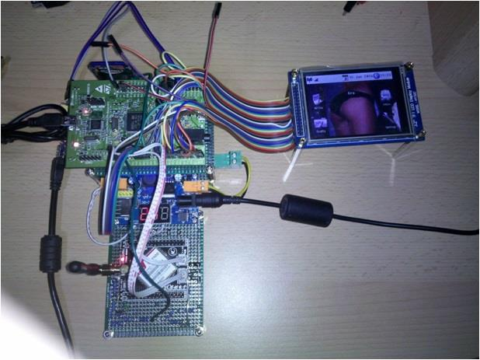
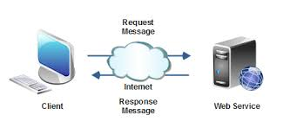
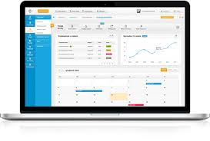
Flow diagram
WEBSERVICE AND ANALYSIS
ACTION AND RESPONSE FROM APP TO MICROCONTROLLER

Slide 15
THANK YOU
☺

