Slide 1
Performance Analysis of Smart Automation Systems
Mentor: Jetendra Joshi Sir
Group Members:
Abhinav Parihar
Hitika Handa
S.R.Rahul
Karanam Rakesh
Kandula Mohan Sai
Dandu Geet Kamal Tej

Slide 2
Preview
Rationale of work.
Objectives of the work.
Methodology.
Results of the work completed.
Difficulty.

Slide 3
Rationale of work
Internet of Things.
Smart Automation Systems.
Smart City.
Residential Automation.
Commercial Automation.
Analysis of Performance Parameters.
Arduino.
Raspberry Pi.
Lora WAN

Slide 4
Objective
Performance Analysis of various devices in physical layer by building a testbed of Home Automation system.
Study of different performance parameters of an automation system.
Analysis of different performance parameters of an automation system using various communication protocols.
Nrf
Bluetooth
BLE
LoRa

Slide 5
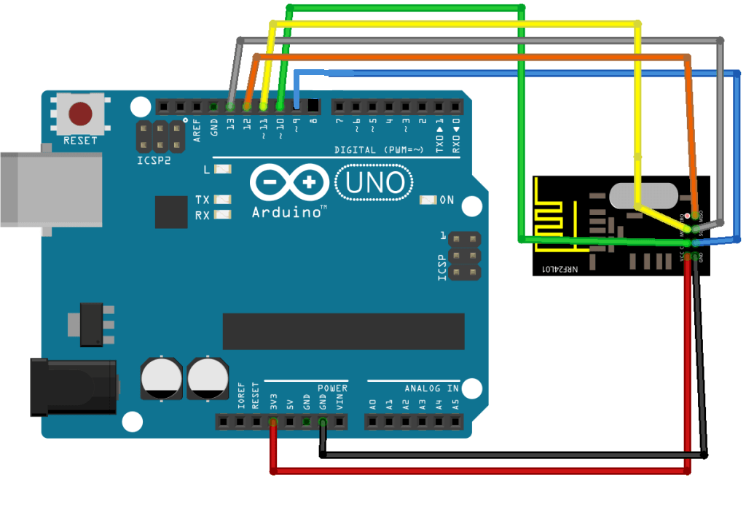
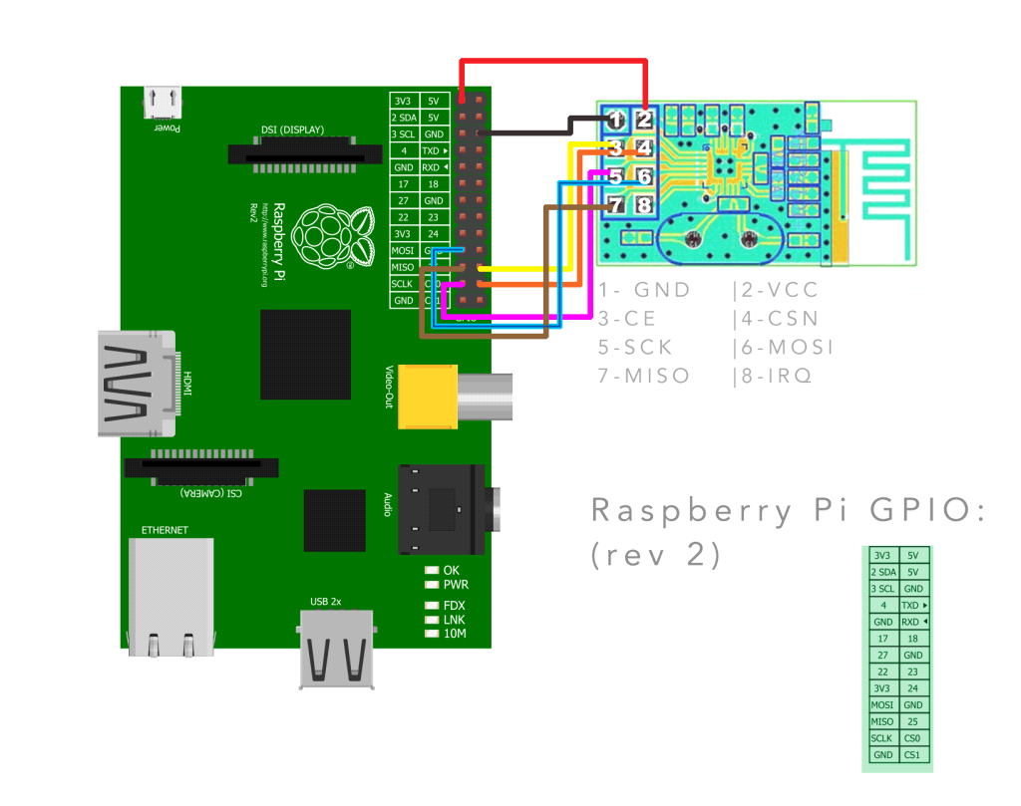
Methodology
To design a testbed of Home Automation for performance analysis of physical layer.
Arduino.
Raspberry Pi.
Image Courtesy: http://randomnerdtutorials.com/nrf24l01-2-4ghz-rf-transceiver-module-with-arduino/
http://hack.lenotta.com/arduino-raspberry-pi-switching-light-with-nrf24l01/

Slide 6
Methodology
To study the different performance parameters related to automation systems.
To analyse the different performance parameters related to automation systems.
To design a testbed prototype using best protocols and devices on basis of analysed results.
To design Smart Water Monitoring Solution using LoRa.

Slide 7
Performance Parameters (QOS)
In electrical engineering, power consumption often refers to the electrical energy over time supplied to operate an electrical appliance.
Network latency is the time from the source sending a packet to the destination receiving it.
Range, Every sensor is designed to work over a specified range. The design ranges are usually fixed, and if exceeded, result in permanent damage to or the sensor may not respond.
Throughput is the rate of successful message delivery over a communication channel.
The frequency at which a component, circuit, device, piece of equipment, or system operates.

Slide 8
Results of the work completed
Analysis of performance parameters using different communication protocols in each module.
We build testbeds of Arduino, Raspberry Pi and LoPy for analysis.
Nrf
Bluetooth
BLE
LoRa
Power Consumption.
Latency.
Range.
Throughput.
Frequency.

Slide 9
NRF24L01 Specifications
On-board 2.4GHz Antenna.
100m Range at 250kbps.
250kbps to 2Mbit Data Rate.
Auto Acknowledge.
Auto Re-Transmit.
Multiceiver – 6 Data pipes
32 Byte separate TX and RX FIFOs

Slide 10
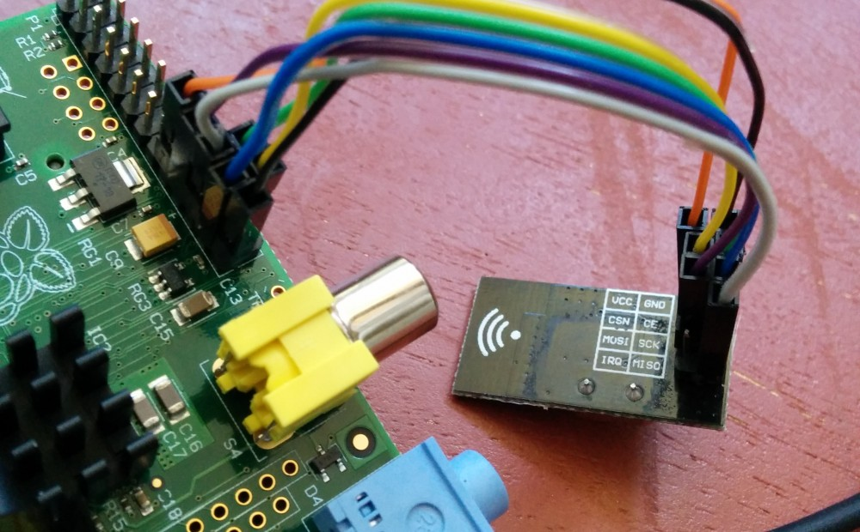
NRF24L01 with Arduino and Raspberry Pi

Slide 11
NRF24L01 setup for Arduino

Slide 12
NRF24L01 setup for Raspberry Pi

Slide 13
NRF24L01 Performance Analysis
Range | Latency | Packets Acknowledged | Throughput
less than 1 meter | 8 ms | 118 packets | 99%
100 meters | 11ms | 94 packets | 96%
150 meters | 23 ms | 57 packets | 95%
200 meters | 45 ms | 14 packets | 81%
Mode | Power Consumption
Transmission | 11.3mA
Reception | 13.1mA
Standby | 900nA

Slide 14
NRF24L01 Output

Slide 15
Bluetooth Specifications
Typical -80dBm sensitivity
Up to +4dBm RF transmit power
Low Power 1.8V Operation ,1.8 to 3.6V I/O
PIO control
UART interface with programmable baud rate
With integrated antenna
With edge connector
Modulation: GFSK(Gaussian Frequency Shift Keying)

Slide 16
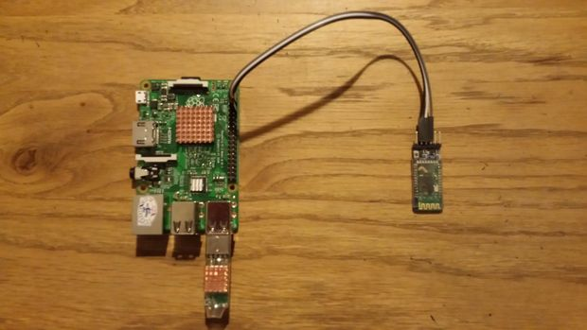
Bluetooth with Arduino and Raspberry Pi

Slide 17
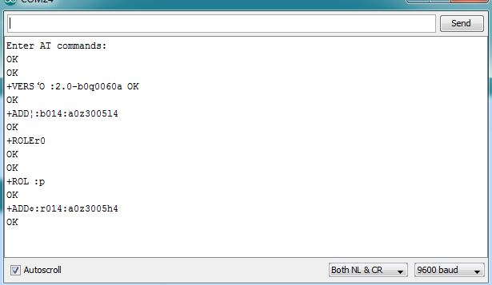
Bluetooth Performance Analysis
Range | Latency | Throughput | Power Consumption
Less than 1 meter | 220 ms | 99% | 40mA
10 meters | 265ms | 98% | 41mA

Slide 18
BLE (Bluetooth Low Energy)

Slide 19
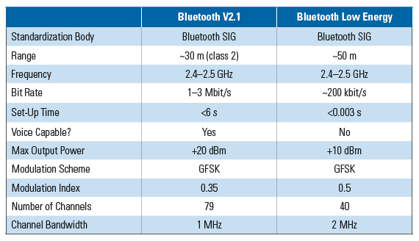
BLE (Bluetooth Low Energy)
Bluetooth version 4.0 is known as Bluetooth Low Energy or BLE.
It is low power variation of original traditional Bluetooth standard.
Like Bluetooth, it is also managed and maintained by Bluetooth SIG.
Due to low power consumption and low power sleep modes, BLE devices can be operated using coin cell for years.
Image Courtesy: http://www.ni.com/newsletter/51685/en/

Slide 20
BLE Performance Analysis
Range | Latency | Throughput | Power Consumption
Less than 1 meter | 206 ms | 99% | 14mA
10 meters | 225ms | 98% | 15mA
50 meters | 270ms | 98% | 15mA

Slide 21
LORAWAN
LoRaWAN is a Low Power Wide Area Network
Support low-cost
Mobile
Secure bi-directional communication for Internet of Things (IoT), machine-to-machine (M2M), and Smart city
Low power consumption
Designed to support large networks with millions and millions of devices
Lora WAN operates in unlicensed radio spectrum.

Slide 22
LoPy

Slide 23
LoPy Specifications
Range Specification
Node range: Up to 40km (when in line of sight).
Nano-Gateway: Up to 5 km (when in line of sight).
Nano Gateway Capacity: up to 100 nodes.
Power
Input: 3.3V - 5.5V.
Wi-Fi:12 mA in active mode, 5uA in standby.
LoRa: 3mA in active mode, 39mA during Tx, 14mA during Rx.
Bluetooth
Bluetooth Smart: Both standard Bluetooth and BLE supported.
BLE: 8mA in active mode, 2uA in standby.

Slide 24
LoPy Performance Analysis
State | Power Consumption
ON | 2.8 mA
Transmitting data | 38.9 mA
Receiving data | 14.2 mA

Slide 25
LoPy (Unconfirmed)
Image Courtesy: https://www.lora-alliance.org/

Slide 26
LoPy
{
uint8_t port = 1;
char data[] = “010203040506070809”;
LoRaWAN.sendUnconfirmed( port, data);
}

Slide 27
LoPy (Confirmed)
Image Courtesy: https://www.lora-alliance.org/

Slide 28
LoPy
{
uint8_t port = 1;
char data[] = “010203040506070809”;
LoRaWAN.sendConfirmed( port, data);
}

Slide 29
LoPy Performance Analysis
Transmit mode | Latency (10–Byte Packet) | Throughput
Send unconfirmed at 5470 bps | 2.7 seconds | 98%
Send unconfirmed at 250 bps | 4.2 seconds | 99%
Send confirmed at 5470 bps | 1.6 seconds | 97%
Send confirmed at 250 bps | 4.1 seconds | 99%

Slide 30
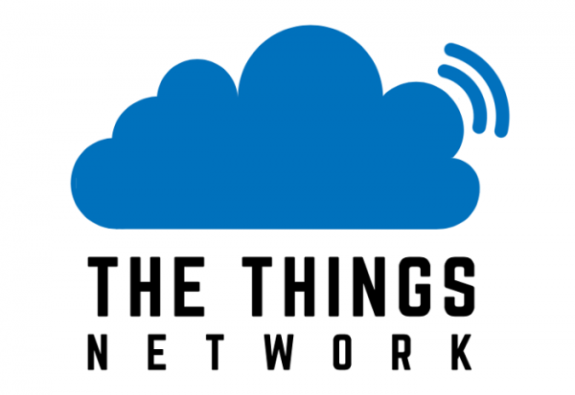
The Things Network
It is a global community of 12776 people over 82 countries building a global Internet of Things data network.
It uses a long range and low power radio frequency protocol called LoRaWAN and for short range Bluetooth 4.2.
The technology allows for things to talk to the internet without 3G or WiFi. So no Wi-Fi codes and no mobile subscriptions.
In order to provision our node on TTN, we need to first get the factory configured Device EUI, which is simple enough to do and involves entering a few lines of Python into the REPL (interpreter prompt). With this we can then register the LoPy against our test application via TTN Console.
Image Courtesy: https://www.thethingsnetwork.org/#

Slide 31
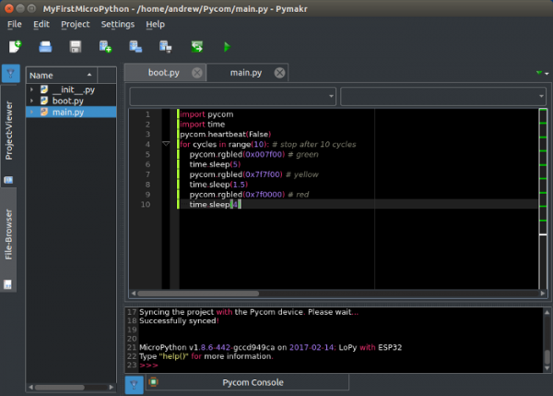
The Things Network
Image Courtesy: https://www.thethingsnetwork.org/#

Slide 32
The Things Network
In India, there are 8 communities based in different cities, Bengaluru, Chennai, Coimbatore, Kochi, Mumbai, Mysore, New Delhi and Pune.
Bengaluru is the official community of The Things Network in India.
But, there is one gateway available in Benguluru community in India.

Slide 33
The Things Network
Image Courtesy: https://www.thethingsnetwork.org/#

Slide 34
Difficulty
For LoRa communication between two or more LoPy modules, we need a gateway connecting them.
The gateway for LoRa is not available and we need to buy it to complete our project.

Slide 35
THANK YOU

