Slide 1
Performance Analysis of Smart Automation Systems
Group Members : Mentor – Jetendra Joshi Sir
Abhinav Parihar
Hitika Handa
S.R.Rahul
Karanam Rakesh
Kandula Mohan Sai
Dandu Geet Kamal Tej

Slide 2
Preview
Rationale of work.
Objectives of the work.
Results of the work completed.
Future work.
Difficulty.

Slide 3
Rationale of work
Internet of Things.
Smart Automation Systems.
Smart City.
Residential Automation.
Commercial Automation.
Analysis of Performance Parameters.
Arduino.
Raspberry Pi.
Lora WAN

Slide 4
Objective
Performance Analysis of various devices in physical layer by building a testbed of Home Automation system.
Analysis of different performance parameters of an automation system using various communication protocols.
Nrf
Bluetooth
BLE
LoRa
To design Smart Water Monitoring Solution and Smart Garbage Management using LoRa.

Slide 5
Results of the work completed
We built a testbed of Home Automation for performance analysis of physical layer.
Analysis of performance parameters using different communication protocols in each module.
We built testbeds of Arduino, Raspberry Pi and LoPy for analysis.
Nrf
Bluetooth
BLE
LoRa
Power Consumption.
Latency.
Range.
Throughput.
Frequency.
We built prototypes of Smart Water Monitoring Solution and Smart Garbage Management using LoRa.

Slide 6
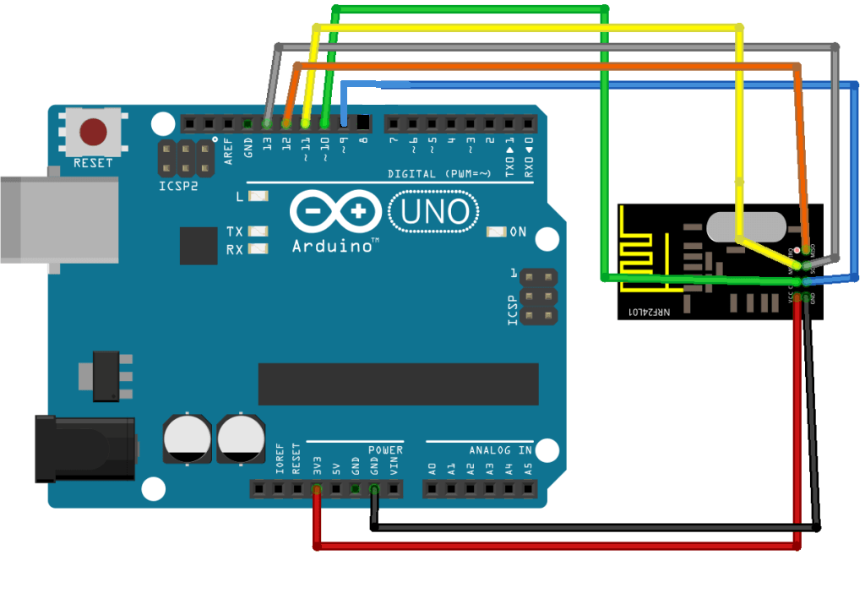
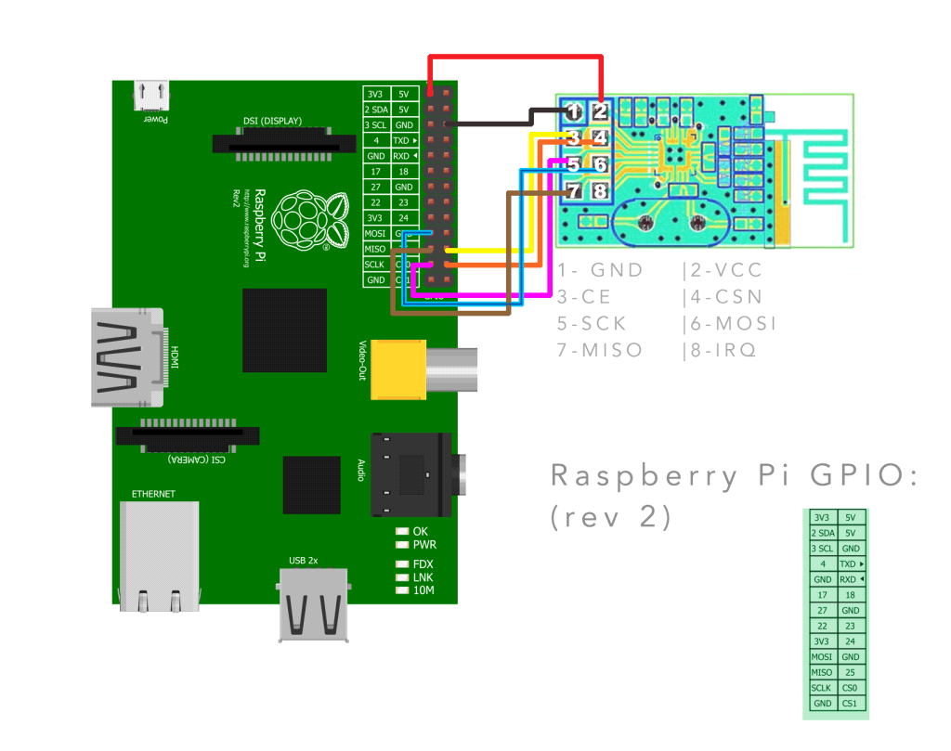
Home Automation
We communicate between these two is to use a application to run a binary ‘sudo ./remote -m 81‘ and ‘sudo ./remote -m 80‘ sending a message to the Arduino with the text 81 and 80 .

Slide 7
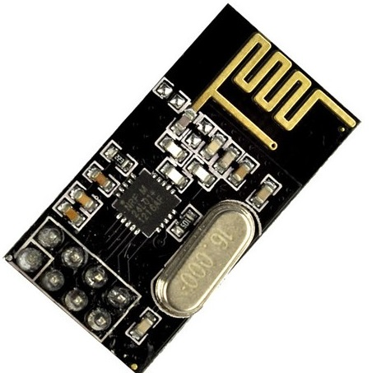
NRF24L01
Specifications
On-board 2.4GHz Antenna.
100m Range at 250kbps.
250kbps to 2Mbit Data Rate.
Auto Acknowledge.
Auto Re-Transmit.
Multiceiver – 6 Data pipes
32 Byte separate TX and RX FIFIOs

Slide 8
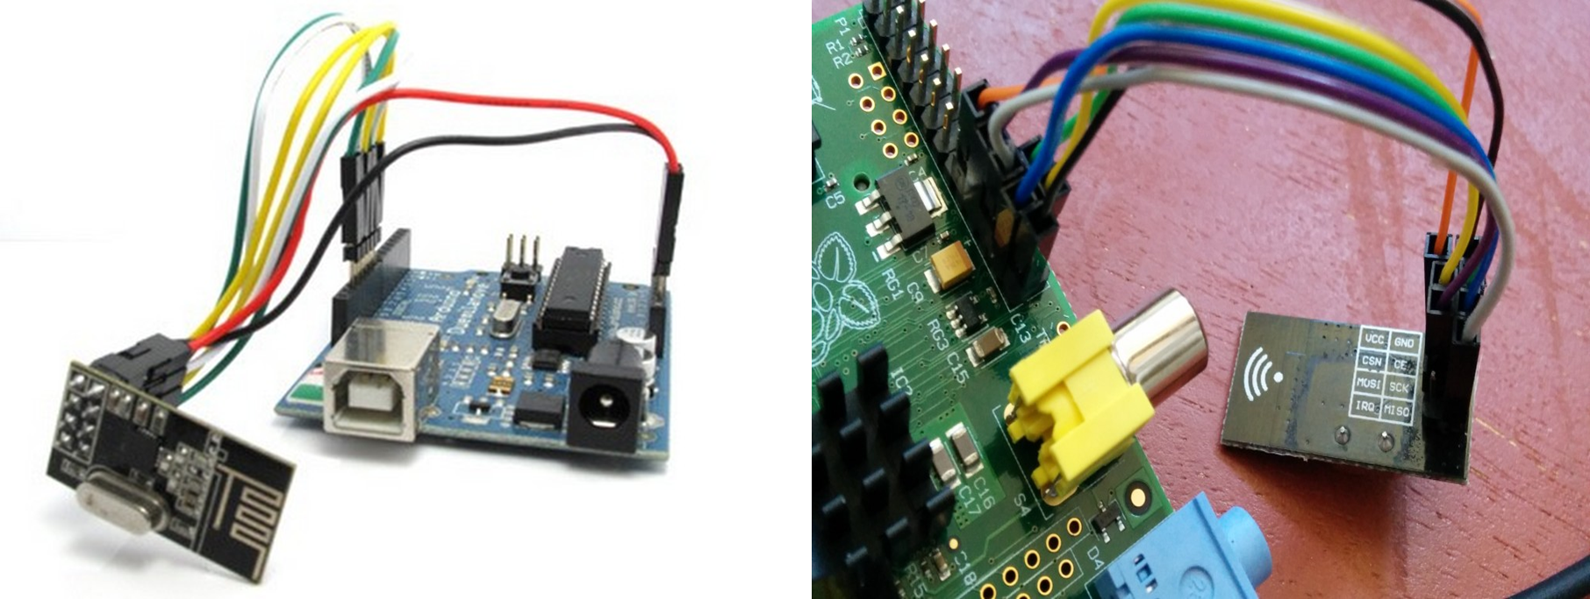
NRF24L01 with Arduino and Raspberry Pi

Slide 9
NRF24L01 Performance Analysis
Range | Latency | Packets Acknowledged | Throughput
less than 1 meter | 8 ms | 118 packets | 99%
100 meters | 11ms | 94 packets | 96%
150 meters | 23 ms | 57 packets | 95%
200 meters | 45 ms | 14 packets | 81%
Mode | Power Consumption
Transmission | 11.3mA
Reception | 13.1mA
Standby | 900nA

Slide 10
NRF24L01 Output

Slide 11
Bluetooth
Specifications
Typical -80dBm sensitivity
Up to +4dBm RF transmit power
Low Power 1.8V Operation ,1.8 to 3.6V I/O
PIO control
UART interface with programmable baud rate
With integrated antenna
With edge connector
Modulation: GFSK(Gaussian Frequency Shift Keying)

Slide 12
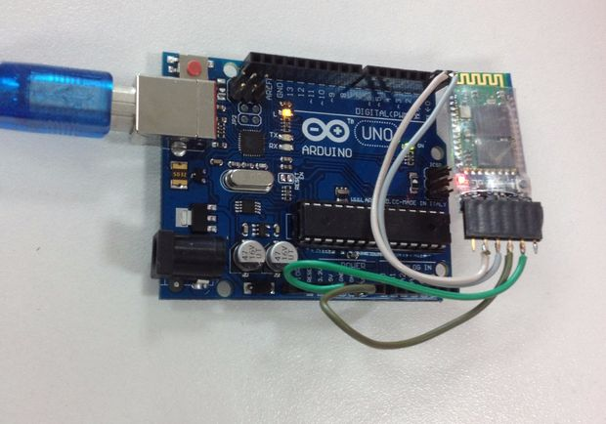
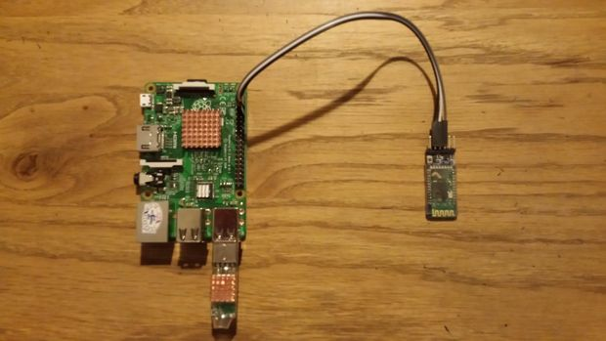
Bluetooth with Arduino and Raspberry Pi

Slide 13
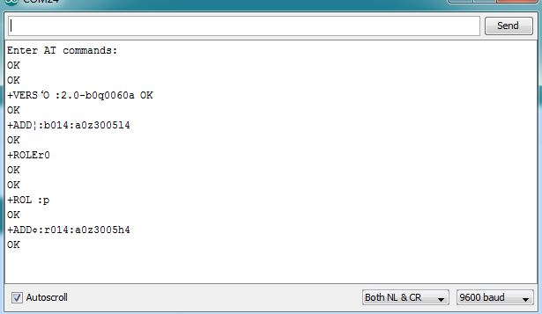
Bluetooth Performance Analysis
Range | Latency | Throughput | Power Consumption
Less than 1 meter | 220 ms | 99% | 40mA
10 meters | 265ms | 98% | 41mA

Slide 14
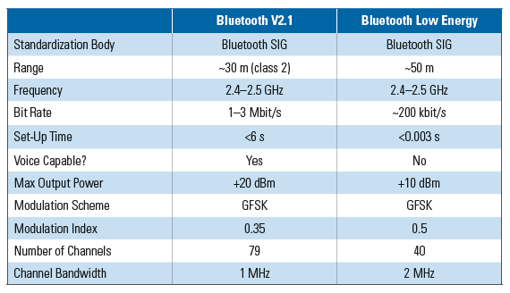
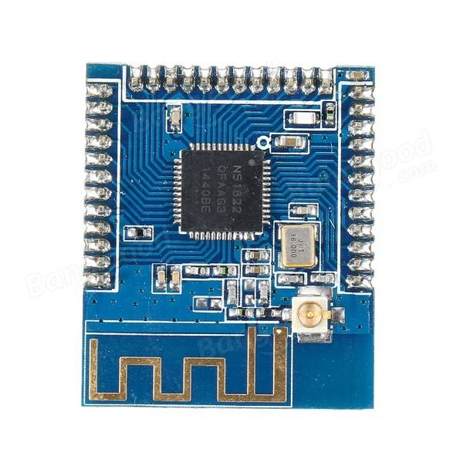
BLE (Bluetooth Low Energy)
Bluetooth version 4.0 is known as Bluetooth Low Energy or BLE.
It is low power variation of original traditional Bluetooth standard.
Like Bluetooth, it is also managed and maintained by Bluetooth SIG.
Due to low power consumption and low power sleep modes, BLE devices can be operated using coin cell for years.

Slide 15
BLE Performance Analysis
Range | Latency | Throughput | Power Consumption
Less than 1 meter | 206 ms | 99% | 14mA
10 meters | 225ms | 98% | 15mA
50 meters | 270ms | 98% | 15mA

Slide 16
LORAWAN
LoRaWAN is a Low Power Wide Area Network
Support low-cost
Mobile
Secure bi-directional communication for Internet of Things (IoT), machine-to-machine (M2M), and Smart city
Low power consumption
Designed to support large networks with millions and millions of devices
Lora WAN operates in unlicensed radio spectrum

Slide 17
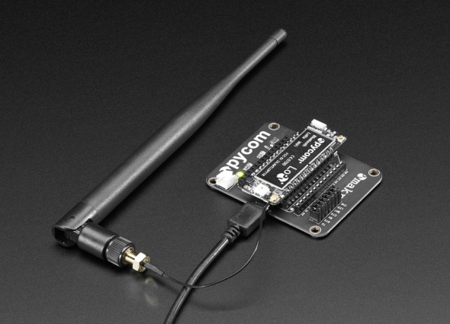
LoPy Specifications
Range Specification
Node range: Up to 40km (when in line of sight).
Nano-Gateway: Up to 5 km (when in line of sight).
Nano Gateway Capacity: up to 100 nodes.
Power
Input: 3.3V - 5.5V.
Wi-Fi:12 mA in active mode, 5uA in standby.
LoRa: 3mA in active mode, 39mA during Tx, 14mA during Rx.
Bluetooth
Bluetooth Smart: Both standard Bluetooth and BLE supported.
BLE: 8mA in active mode, 2uA in standby.

Slide 18
LoPy Performance Analysis
State | Power Consumption
ON | 2.8 mA
Transmitting data | 38.9 mA
Receiving data | 14.2 mA

Slide 19
LoPy Performance Analysis
Transmit mode | Latency (10–Byte Packet) | Throughput
Send unconfirmed at 5470 bps | 2.7 seconds | 98%
Send unconfirmed at 250 bps | 4.2 seconds | 99%
Send confirmed at 5470 bps | 1.6 seconds | 97%
Send confirmed at 250 bps | 4.1 seconds | 99%

Slide 20
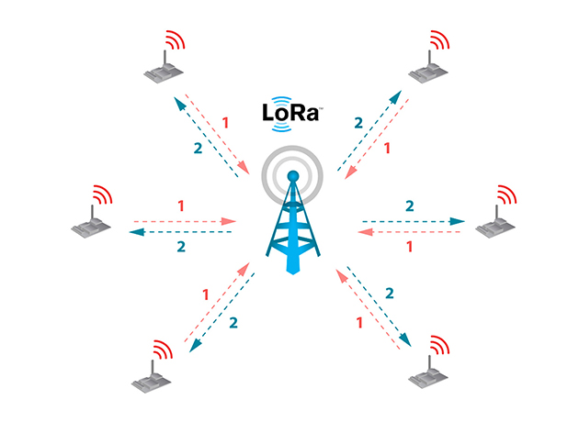
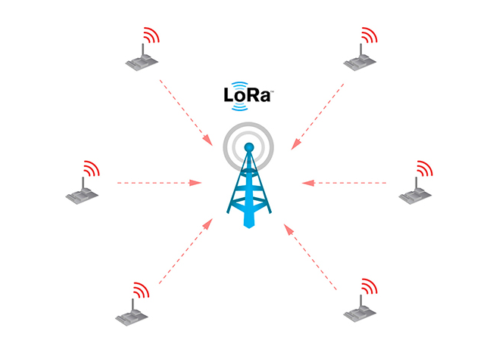
Image Courtesy: https://www.lora-alliance.org
LoPy (Confirmed)
LoPy (UnConfirmed)
LoRaWAN.sendConfirmed( port, data);
LoRaWAN.sendUnconfirmed( port, data);

Slide 21
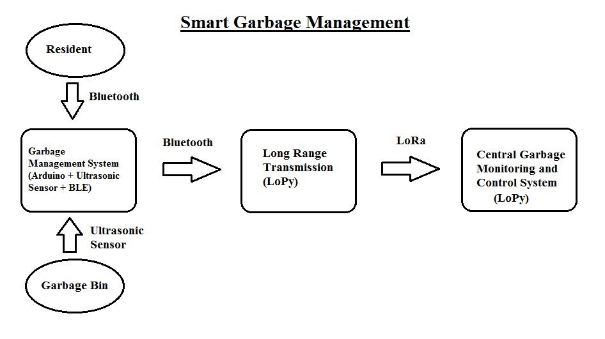
Smart Garbage Management

Slide 22
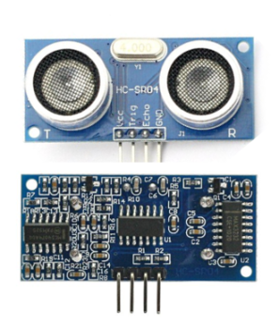
Ultrasonic Ranging Module HC - SR04

Slide 23
Ultrasonic Ranging Module HC - SR04
Product Features:
Ultrasonic ranging module HC - SR04 provides 2cm - 400cm non-contact measurement function, the ranging accuracy can reach to 3mm. The modules includes ultrasonic transmitters, receiver and control circuit. The basic principle of work:
Using IO trigger for at least 10us high level signal,
The Module automatically sends eight 40 kHz and detect whether there is a pulse signal back.
IF the signal back, through high level , time of high output IO duration is the time from sending ultrasonic to returning.

Slide 24
Problem Scenario
The scenario is if the garbage bin is filled, it should be informed to the central garbage control system which will far from the house or the locality.
If a resident has any complaint or he/she intentionally need to clear the thrash due to some reasons like bad odour, before the garbage bin is filled.

Slide 25
Solution Proposed
We used an Arduino microcontroller and LoPy module to interface the sensors and communication protocols.
We used an ultrasonic sensor to know whether the garbage bin filled.
If filled, it sends a message to the LoPy module using a BLE module.
As Lopy is a Long Range communication module, it immediately sends this message to the Central Management System (LoPy) using LoRa protocol.
If an individual is willing to call the service, he can send it through an app in the mobile which uses Bluetooth.

Slide 26
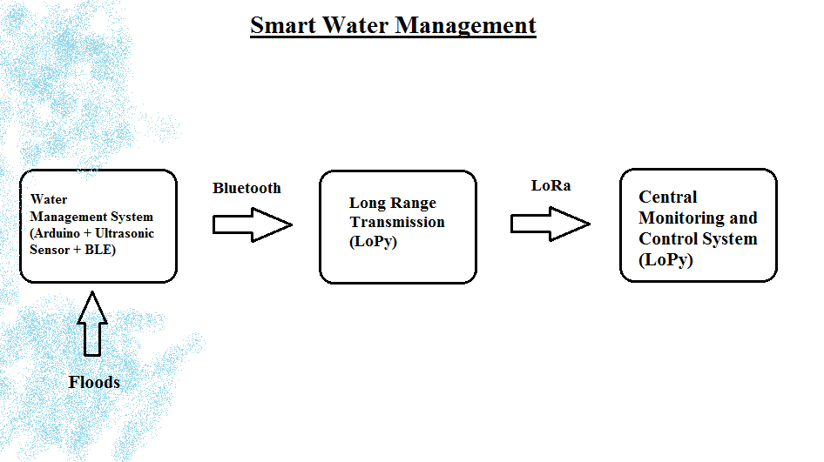
Smart Water Management

Slide 27
Problem Scenario
When floods occur many lives near the coastal region are in danger.
As they travel at a high rate of speed we need to quickly send alert to evacuate a large area near the region.
We need a long range communication to take care of this.

Slide 28
Solution Proposed
We used an Arduino microcontroller and LoPy module to interface the sensors and communication protocols.
We used an ultrasonic sensor to know whether the water is approaching beyond the threshold level.
If crossed the value, it sends a message to the LoPy module using a BLE module.
As LoPy is a Long Range communication module, it immediately sends this message to the Central Management System (LoPy) using LoRa protocol.
An immediate action can be taken and the surrounding region can be evacuated.

Slide 29
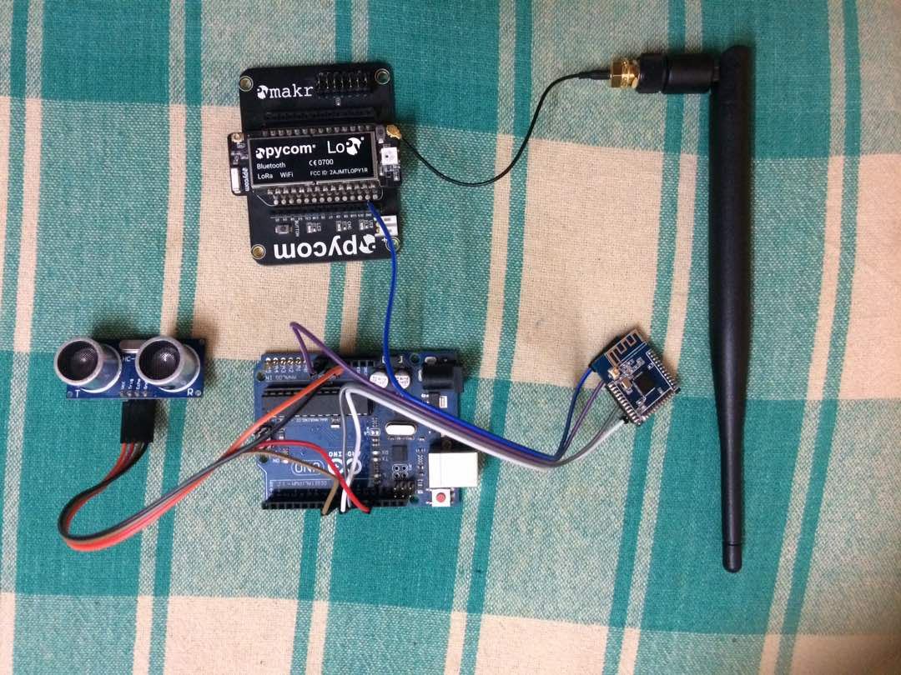
Hardware

Slide 30
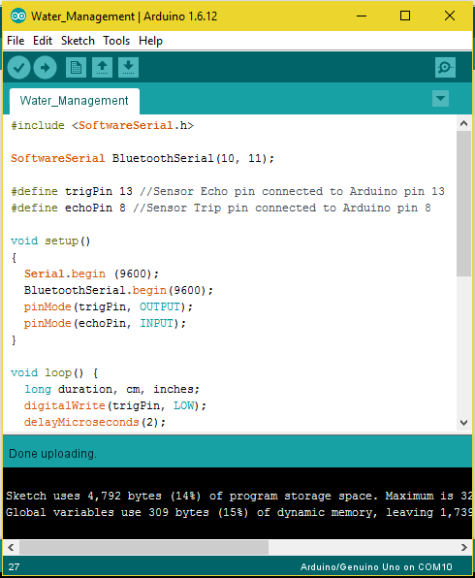
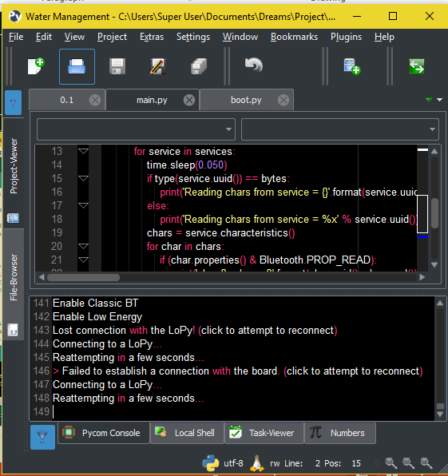
Software

Slide 31
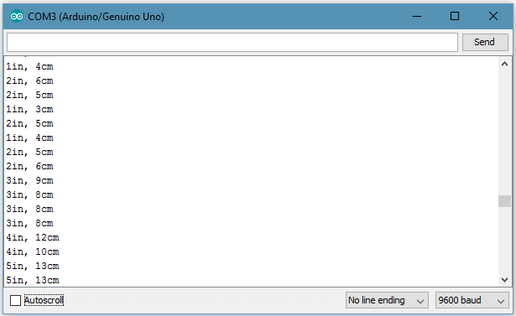
Results

Slide 32
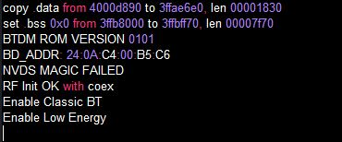
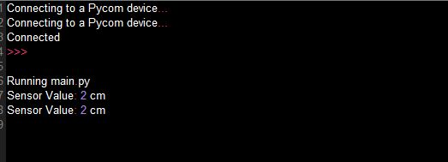
Results

Slide 33
Future Works
We are going to work on other application scenarios specifically in Intelligent Vehicular Networks.
LoRaWAN uses the AES 128 algorithm to encrypt messages, which is a non-optimal encryption that can be deciphered by someone willing enough. So, we are going to work on these security aspects.
We are also working on a research paper based on our proposed solution.

Slide 34
Difficulty
For LoRa communication between more LoPy modules, we need a gateway connecting them.
The gateway for LoRa is not available and we need to buy it to enhance our project.

Slide 35
THANK YOU

