Slide 1
SMART FLOOD MONITORING SOLUTION
Mentors: Prof. Amitava Mukharjee
Prof. Ram Narayan Yadav

Slide 2
PROJECT TEAM MEMBERS
Aakash Kodamasimham
A Mallika Sri Vidya
J Sai Hemanth
K Sachin Reddy
M Manohar
M Pradyumna
M Supraja Reddy
S R Rahul
T Sasi Diamond
V Vineel Reddy

Slide 3
Abstract
This mini project entitles Flood Monitoring System. The purpose of this project is to improve road user safety when occurrence of flash flood. Our target for this project is in those areas that frequently occurrence flash flood especially in coastal areas. Nowadays, the road user will be trapped in flash flood because of the information about flash flood always delay. Now, this project gives road user alternative to provide them from the flash flood. Firstly, the ultrasonic sensor will be placed into the river to detect the level of river water. When the water rate increases , the reading of water level of river will be shown at monitor. If the water level reaches in beyond threshold, the alert is send central management system and also logged in the cloud and website. An email is also sent to the related individual.

Slide 4
System Model
Developing a flood warning system requires attention to three basic factors:
Data collection.
Data processing.
The hardware and software required and the dissemination of flood warning information.

Slide 5
Problem Definition
When floods occur many lives near the coastal region are in danger.
As they travel at a high rate of speed we need to quickly send alert to evacuate a large area near the region.
We need a long range communication to take care of this.
We need a real time monitoring system for frequent flood prone regions.

Slide 6
Contributions
Hardware Implementation:
A. Mallika. - Ultrasonic Sensor
K. Sachin Reddy. - Arduino
S. R. Rahul. - LoPy
T. Sasi Diamond. - Bluetooth
Software Implementation:
J. Sai Hemanth. – Website Frontend Development
M. Manohar. – Website Frontend Development
M. Supraja Reddy – Data Acquisition into Cloud and Email generation.
V. Vineel Reddy. - Data Acquisition into Cloud and Email generation.
M. Pradyumna - Website Backend Development
K. Akash - Website Backend Development

Slide 7
MODEL-BASED MONITORING FOR EARLY WARNING FLOOD DETECTION
Current Model:
It rely on volunteers and limited technology. Volunteers read the river level oﬀ of markings painted on bridges and the rain level from water collecting gages at several intervals during a day.
Records the values in a book, and compares them to a deﬁned policy whereby the river level measured corresponds to a color alert.
Which then decides on the need for an evacuation alert in that region and implements some form of emergency alert procedures.
Relies on very little technology and extensive policies to warn communities.

Slide 8
Algorithm/Protocol
Prediction Model:
Algorithm requires rainfall, air temperature, and water ﬂow data collected and transmitted in real-time over the entire river basin area multiple times per hour.
Since the ﬂow of a river may change signiﬁcantly over a period of several minutes, this suggest a sampling rate on the order of minutes.
In order to support distributed, robust, real-time data collection, transmission, and, eventually, processing for large geographic regions corresponding to real river basins, with some deﬁned system requirements.

Slide 9
FLOOD MONITORING AND DETECTION SYSTEM USING WIRELESS SENSOR NETWORK
The Flood Monitoring and Detection System (FMDS) uses a ZigBee radio which uses ZigBee/IEEE 802.15.4 standard which is the only standard-based technology designed to address the unique needs of low-cost, low-power wireless and control networks.
The sensors - Temperature, Rainfall, Humidity and Water Level sensors capture signals (data) and send them to the microcontroller (PIC24).
The data sent is analog in nature, which is digitalized by Analog-Digital converter the microcontroller integrates.
The Zigbee module sends the information it receives from its radio to the microcontroller for processing.
The microcontroller can also send packets received from the sensors to the Zigbee module so that it can be radiated and received by other nodes.

Slide 10
SMS BASED FLOOD LEVEL MONITORING SYSTEM
The main objective of the proposed system is to be able to read the water level at every second, display it to the supervisor and alert the affected populace and relevant authorities by means of an alarm and short message system (SMS) when the level of water surpasses a user defined threshold.
Global System for Mobile Communications (GSM) network has been used for sending the mobile messages.
Peripheral Interface Controller (PIC) microprocessor is used to read in the input from the sensor and then display the result.
The measuring system is based upon the theory of pressure being applied to liquids.
Furthermore, the collated data is useful to the meteorologist for investigating and monitoring the cause of flooding with respect to time and weather patterns.

Slide 11
AN INTEGRATED SYSTEM FOR REGIONAL ENVIRONMENTAL MONITORING AND MANAGEMENT BASED ON IOT
Climate change and environmental monitoring and management have received much attention recently, and an integrated information system (IIS) is considered highly valuable.
IISs, which involve multiple types of technologies and tools of information and computer sciences, provide a good solution to the complex tasks in environmental monitoring and management.
IIS is an array of multiple information sets linked together in an organized way.
IISs and tools have been widely used in practicing environmental monitoring and management including ecosystem assessment and resources management.

Slide 12
GSM & WEB-BASED FLOOD MONITORING SYSTEM
The purpose of the project is to develop a local real-time river flood monitoring and warning system for the selected communities near Mandulog River.
This study focuses only on the detection and early warning alert system (via website and/or cell phone text messages) that alerts local subscribers of potential flood events.
Furthermore, this system is interactive wherein all non-registered subscribers could inquire the actual water level of the desired area location they want to monitor.
An estimated time a particular river waterway will overflow is also included in the analyses.
The hardware used in the design is split into several parts namely: the water level detector, GSM module, and microcontroller development board

Slide 13
GSM & WEB-BASED FLOOD MONITORING SYSTEM
Introduction:
Residents from flat areas beside the mouth of Mandulog River were greatly affected by typhoon Sendong (2011) and Pablo (2012).
This river had a waterway more than 50 kilometers long which serves as the main drain of the mountainous area which covers about 70,000 hectares of land.
The watershed covers hundreds of smaller rivers connected to Mandulog River and form a network of channels similar to the branches of a tree.
It is the main trunk where most of the storm water collected by the mountain watershed passes through before reaching the sea (Ilagan Bay).

Slide 14
GSM & WEB-BASED FLOOD MONITORING SYSTEM
Proposed research:
This project builds a prototype that will detect the current water level across the watershed of Mandulog River and its surrounding areas through sensors.
The geographical area of the river was sub-divided into areas where sensors were installed. Each sensor signifies a warning level.
Once a sensor is triggered, an output signal will be relayed to a microcontroller which serves as a switch that triggers the connected GSM modem to send alert SMS message to the server.
Then, the server will automatically send a text message to the numbers stored in the database.

Slide 15
GSM & WEB-BASED FLOOD MONITORING SYSTEM
(Continued)
Also, the computer will then automatically relay the alert signal by uploading a warning post on a website or to social media sites like Facebook and Twitter.
The process repeats as the water level continues to rise and triggers another sensor.
Once the water level reaches its critical point, it will relay a message giving warning to the nearby areas.
Furthermore, communities could inquire by a sending message thru keywords.

Slide 16
GSM & WEB-BASED FLOOD MONITORING SYSTEM
(Continued)
Also, the computer will then automatically relay the alert signal by uploading a warning post on a website or to social media sites like Facebook and Twitter.
The process repeats as the water level continues to rise and triggers another sensor.
Once the water level reaches its critical point, it will relay a message giving warning to the nearby areas.
Furthermore, communities could inquire by a sending message thru keywords.

Slide 17
Solution Proposed
We used an Arduino microcontroller and LoPy module to interface the sensors and communication protocols.
We used an ultrasonic sensor to know whether the water is approaching beyond the threshold level.
If crossed the value, it sends a message to the LoPy module using a BLE module.
As LoPy is a Long Range communication module, it immediately sends this message to the Central Management System (LoPy) using LoRa protocol.
An immediate action can be taken and the surrounding region can be evacuated.

Slide 18
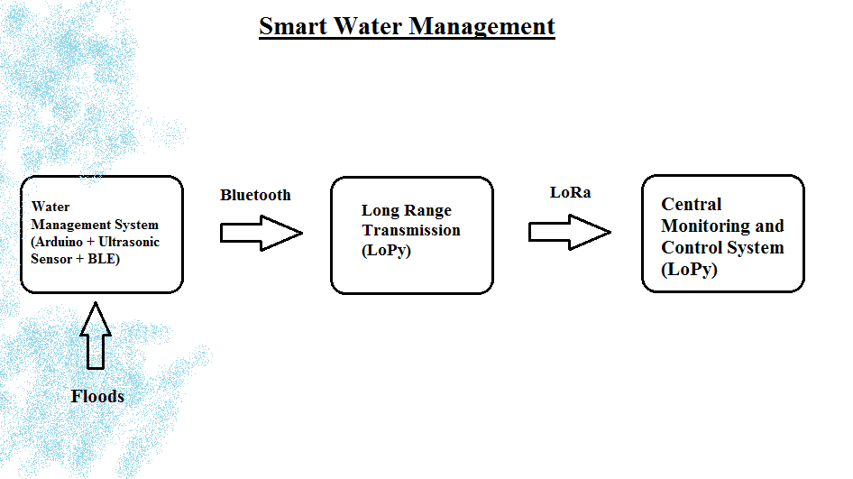
ALGORITHM

Slide 19
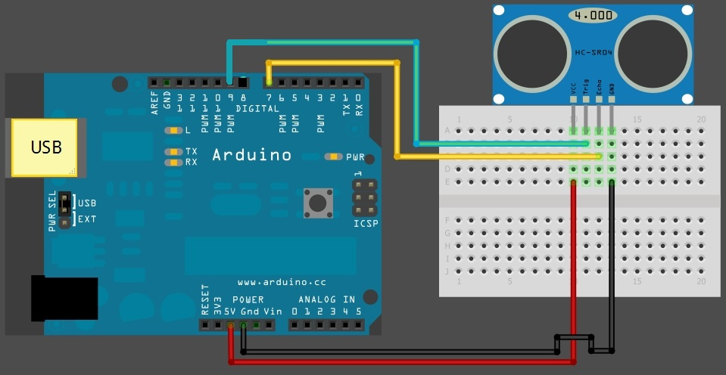
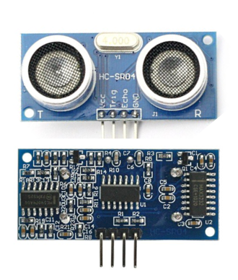
ULTRASONIC SENSOR

Slide 20
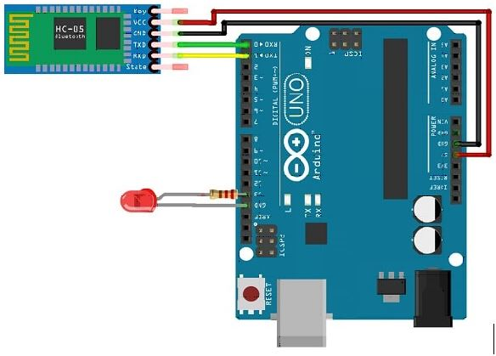
BLUETOOTH

Slide 21
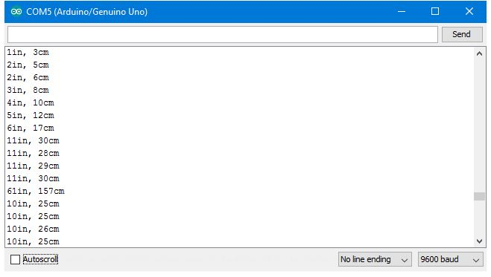
SENSOR OUTPUT

Slide 22
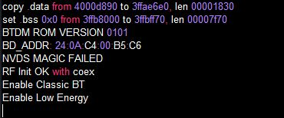
PYMAKR OUTPUT

Slide 23
THINGSPEAK CLOUD

Slide 24
THING HTTP

Slide 25
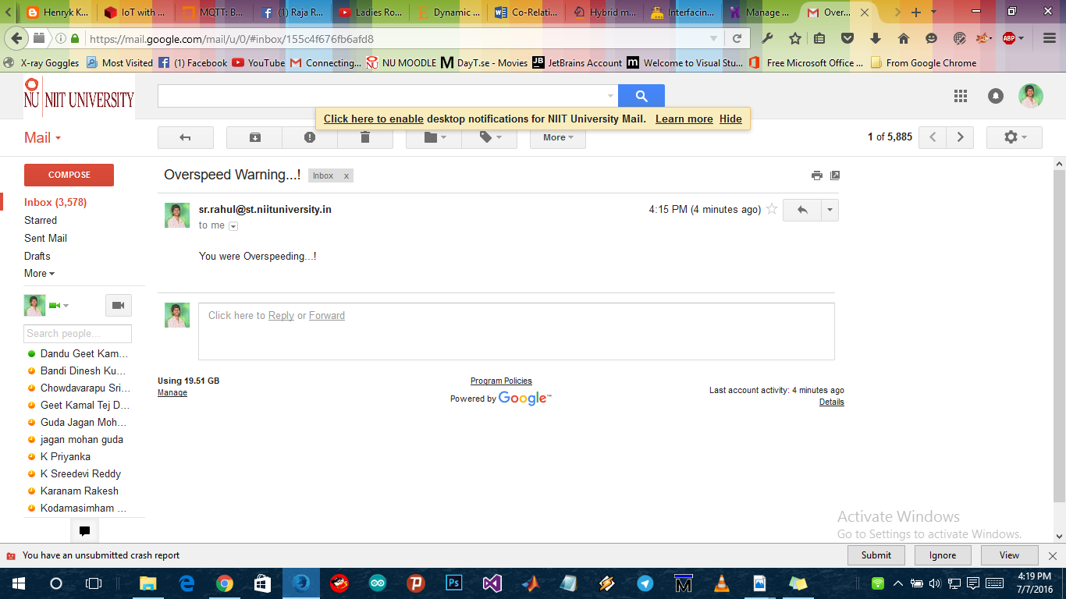
MAIL

Slide 26
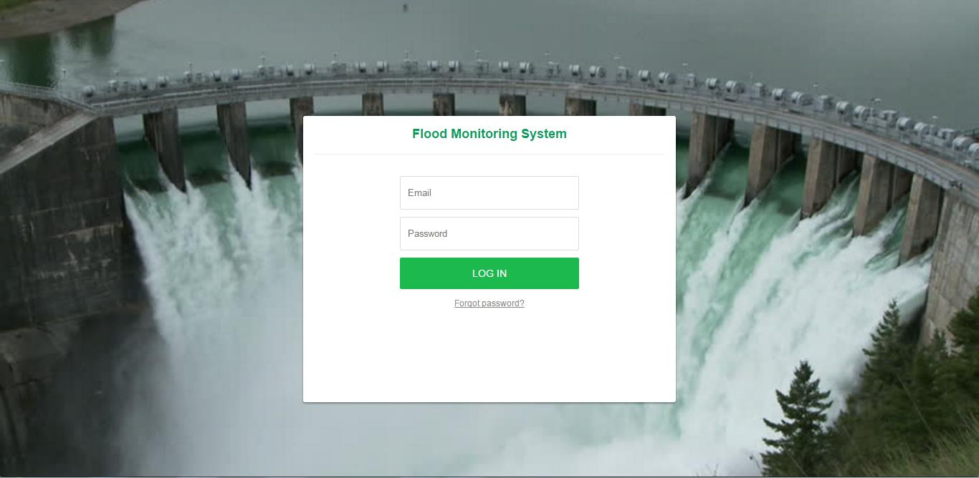
CENTRAL MONITORING WEBSITE

Slide 27
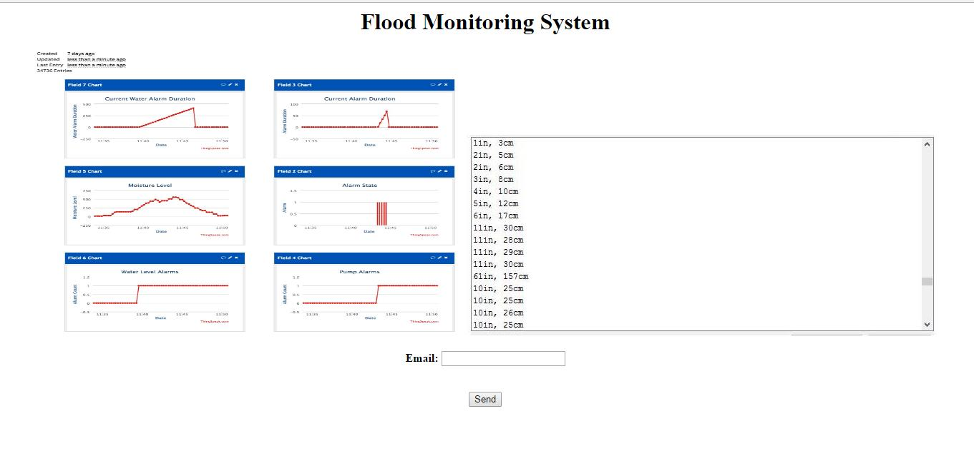
CENTRAL MONITORING WEBSITE

Slide 28
Conclusion
Till today, there is very little work done in the area of LoRa. So, we adopted Lora protocol for our project and we have done our best to make a more reliable flood management system.
We have done Flood detection, monitoring and control system.
We are working on implementation of Floods Prediction algorithms.

Slide 29
References
[1] Elizabeth A. Basha, Sai Ravela and Daniela Rus, “Model-Based Monitoring for Early Warning Flood Detection”, SenSys’08, November 5–7, 2008, Raleigh, North Carolina, USA. Copyright 2008 ACM 978-1-59593-990-6/08/11.
[2] Edward N. Udo and Etebong B. Isong, “Flood Monitoring and Detection System using Wireless Sensor Network”, ASIAN JOURNAL OF COMPUTER AND INFORMATION SYSTEMS (ISSN: 2321 – 5658).
[3] Sheikh Izzal Azid and Bibhya Nand Sharma, “SMS BASED FLOOD LEVEL MONITORING SYSTEM”, Faculty of Science Technology and Environment, The University of South Pacific Suva Fiji.
[4] Shifeng Fang; Li Da Xu; Yunqiang Zhu; Jiaerheng Ahati; Huan Pei; Jianwu Yan; Zhihui Liu, “An Integrated System for Regional Environmental Monitoring and Management Based on Internet of Things”, IEEE Transactions on Industrial Informatics ( Volume: 10, Issue: 2, May 2014 )
[5] J C Pagatpat1 , AC Arellano and OJ Gerasta, “GSM &web-based flood monitoring system”, 1st International Conference in Applied Physics and Materials Science.

Slide 30
THANK YOU

